Slide 1
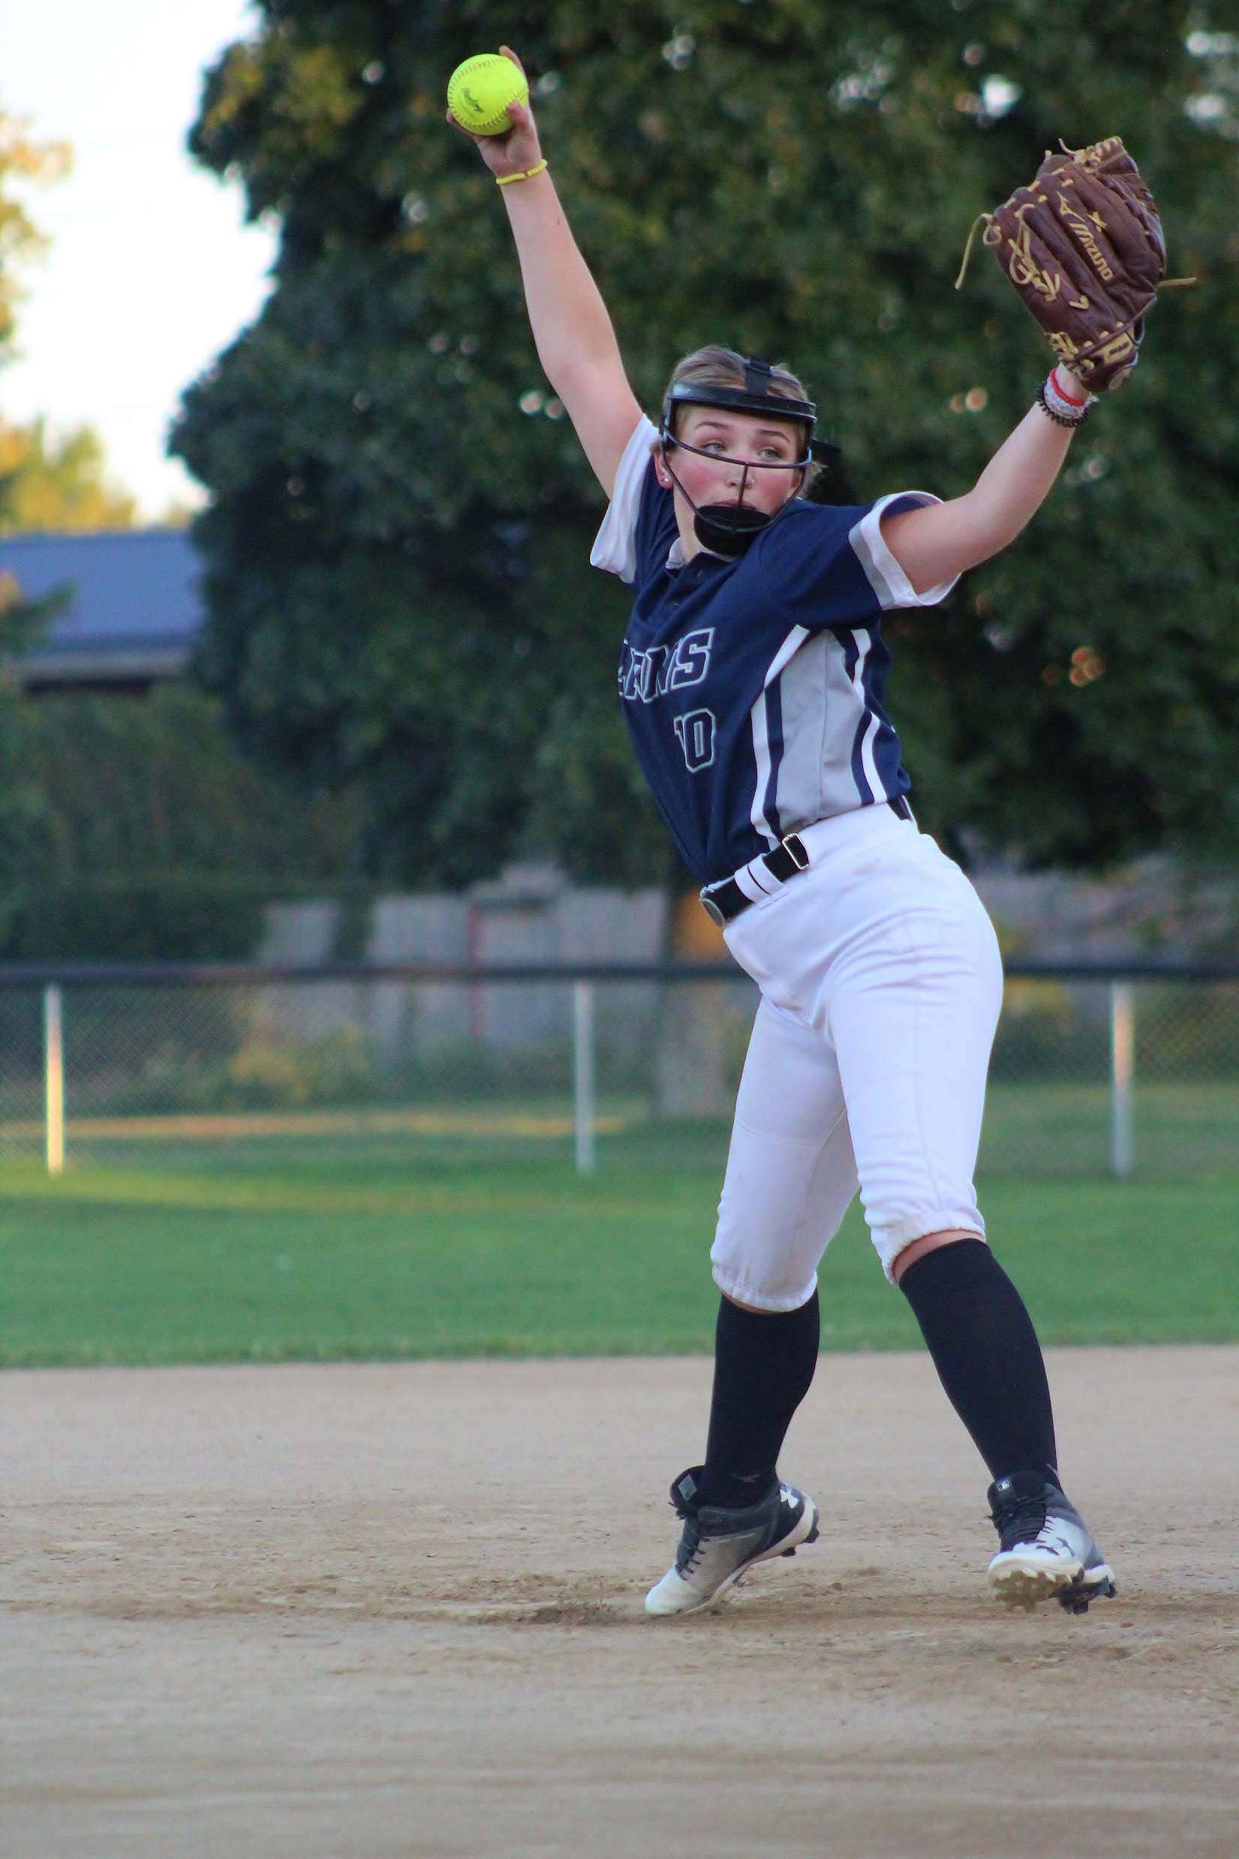
Leo Hayes High School
Vaughn Academic Award:
Top Academic Standing by a Graduating Student-Athlete.
Carrie Pelkey

Slide 2

Leo Hayes High School
Vaughn Academic Award:
Top Academic Standing by a Graduating Student-Athlete.
Nick Rushton

Slide 3
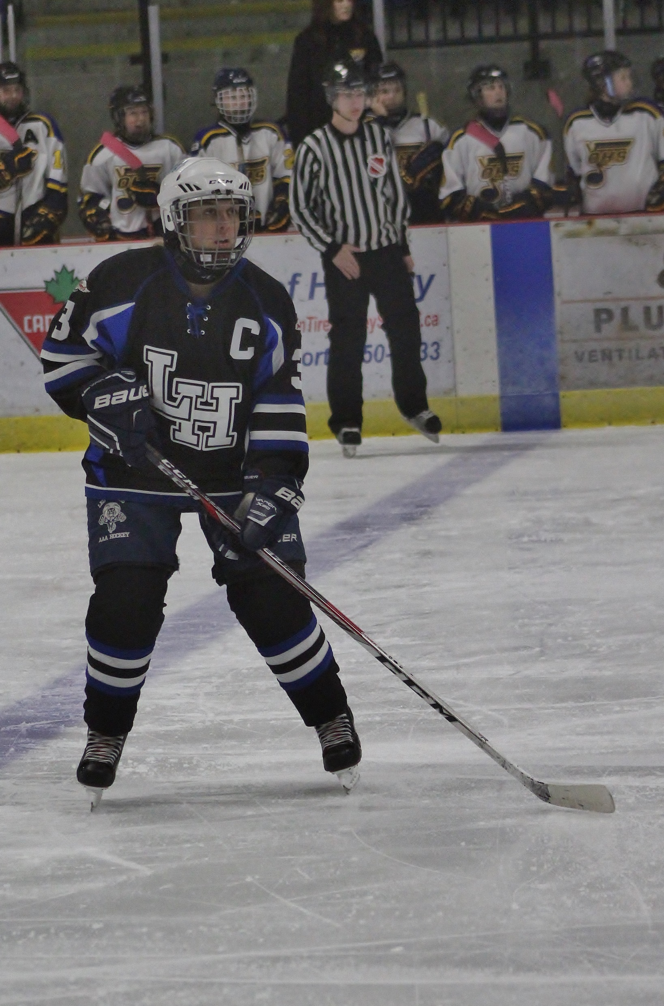
LEO Hayes High School
Coaches Choice Award.
Given annually by the Athletics Department, to an athlete who best demonstrates, throughout the season, the true spirit of Lion's Athletics.
Emma Betts

Slide 4
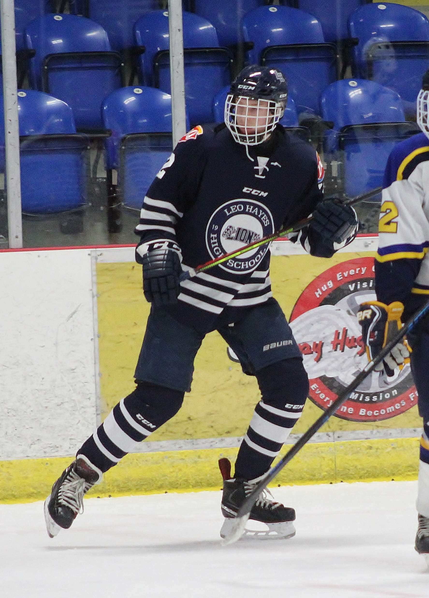
LEO Hayes High School
Coaches Choice Award.
Given annually by the Athletics Department, to an athlete who best demonstrates, throughout the season, the true spirit of Lion's Athletics.
Scott Whitters

Slide 5
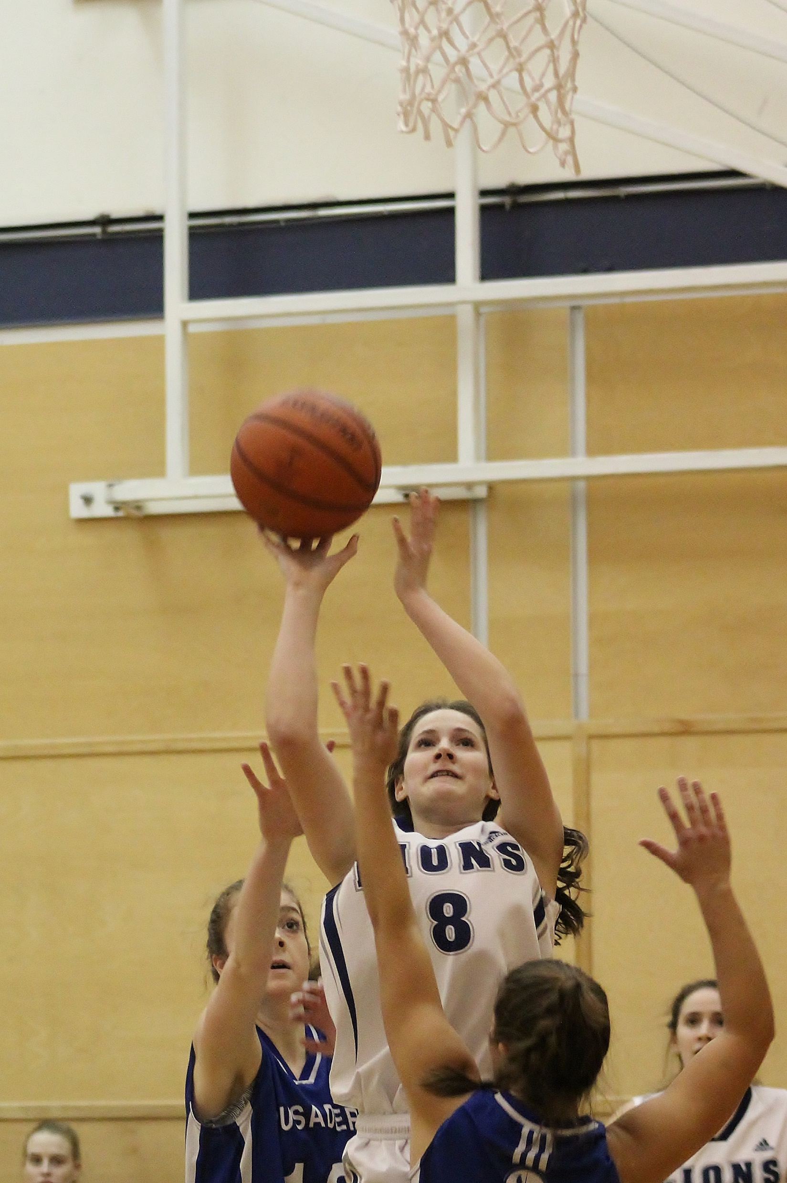
LEO Hayes High School
Junior Varsity
Athlete of the Year.
Given annually to a student currently in grade 9 or 10 who is a positive role model on and off the court.
Sydney Grant

Slide 6
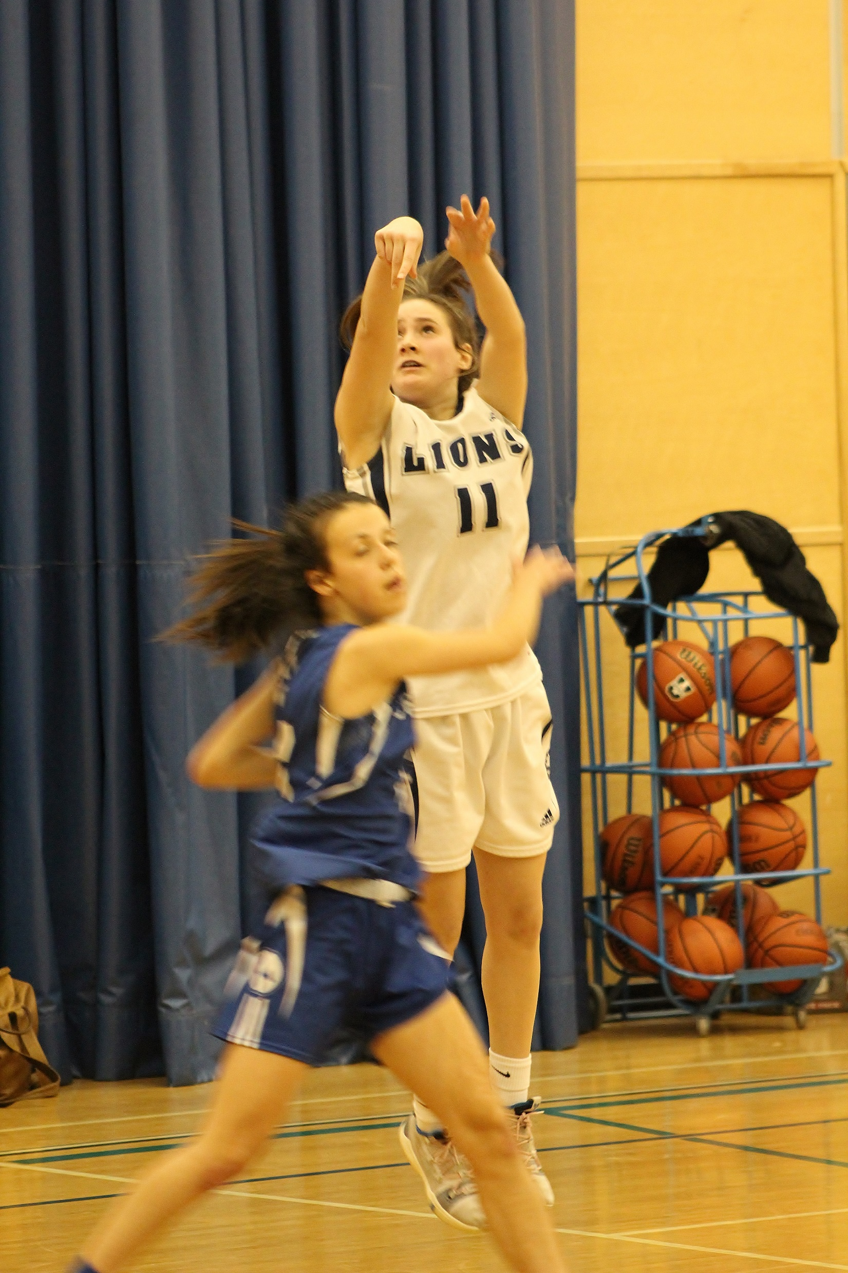
LEO Hayes High School
Junior Varsity
Athlete of the Year.
Given annually to a student currently in grade 9 or 10 who is a positive role model on and off the court.
Sydney Grant

Slide 7

LEO Hayes High School
Junior Varsity
Athlete of the Year.
Given annually to a student currently in grade 9 or 10 who is a positive role model on and off the court.
Demitri Shakotko

Slide 8
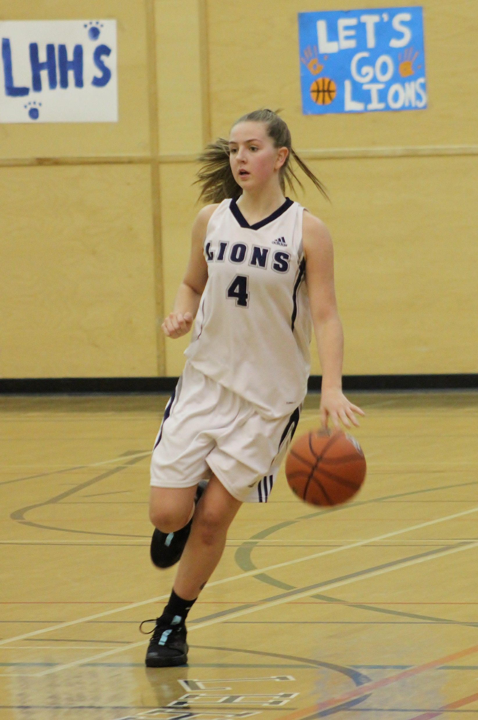
LEO Hayes High School
Varsity Athlete of the Year.
Given annually to a student currently in grade 10 or 11 who is a positive role model on and off the court.
Kylee Speedy

Slide 9
LEO Hayes High School
Varsity Athlete of the Year.
Given annually to a student currently in grade 11 or 12 who is a positive role model on and off the court.
Nick Rushton

